Slide 1
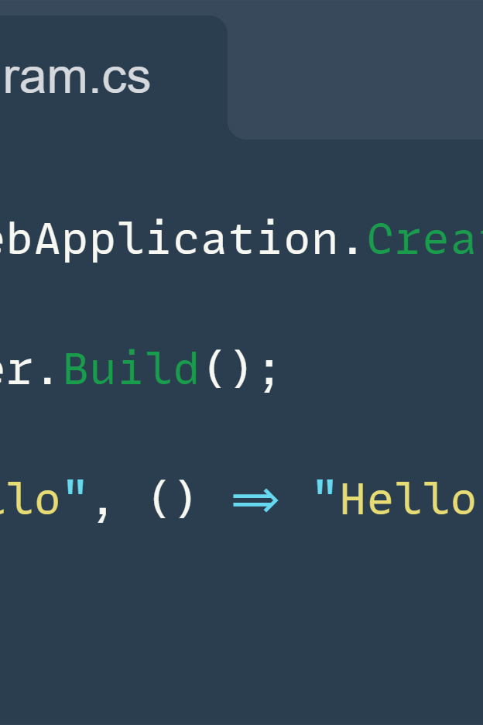



ASP.NET Core - Minimal API
Milan Martiniak

Slide 2


Kto bol na prednáške Martina Kumeckého?
Kto mate skúsenosti s API?
Kto mate skúsenosti s .NET?
Kto máte skúsenosti s REST API v .NET?
Kto poznáte Minimal API?

Slide 3
Prečo API (REST API)?

Slide 4


Slide 5
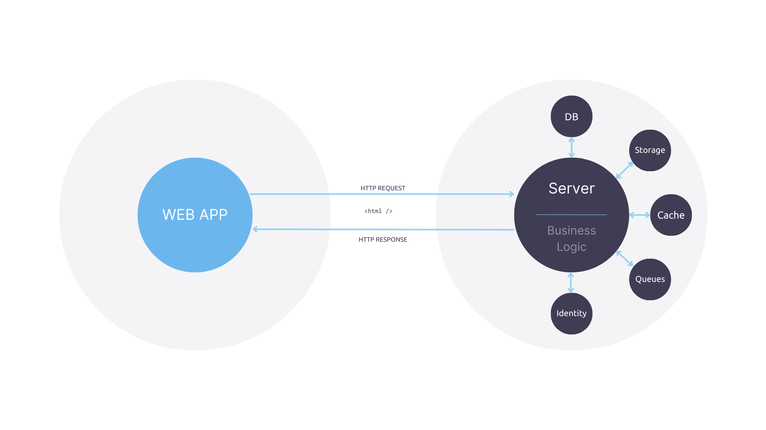

Slide 6
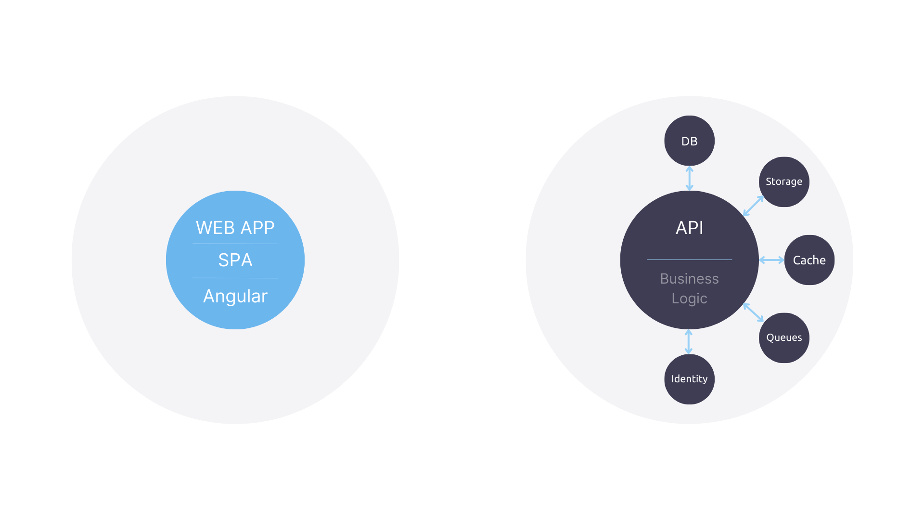

Slide 7
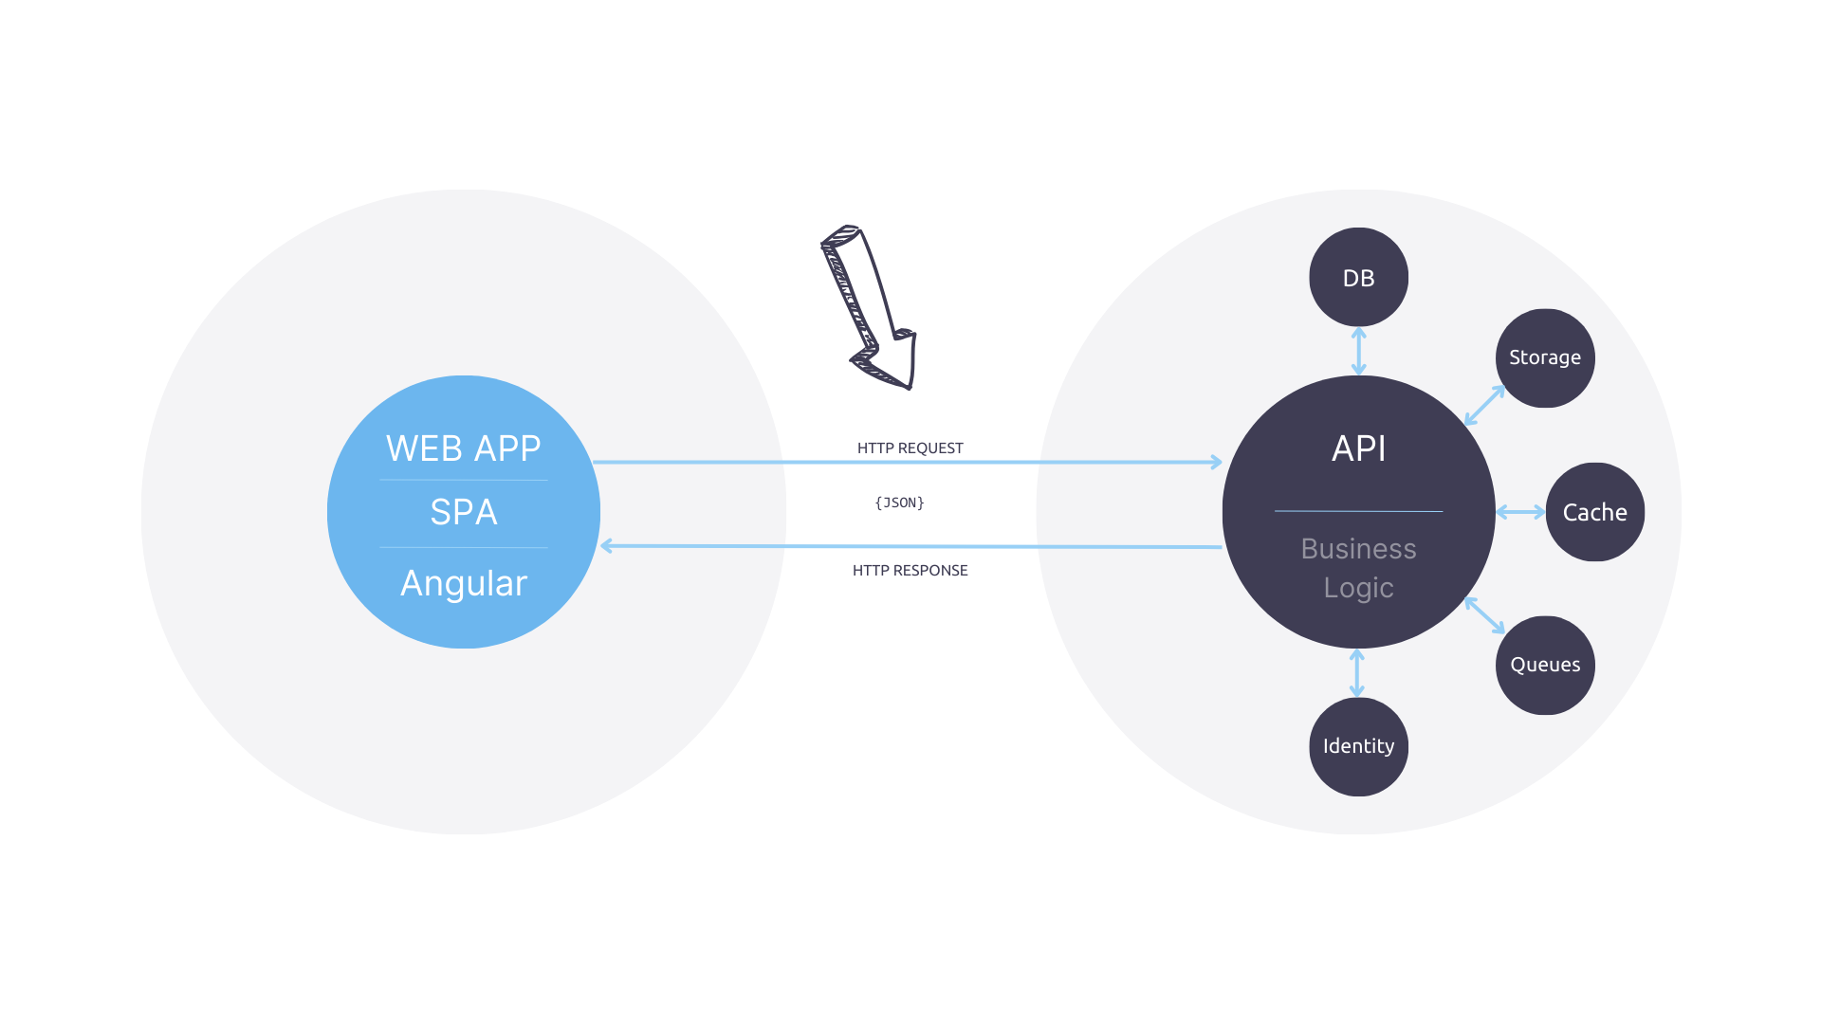

Slide 8
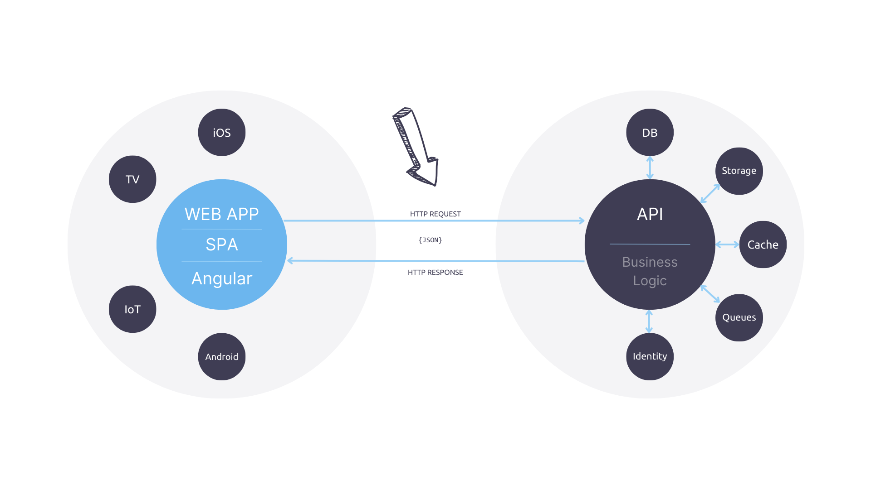

Slide 9
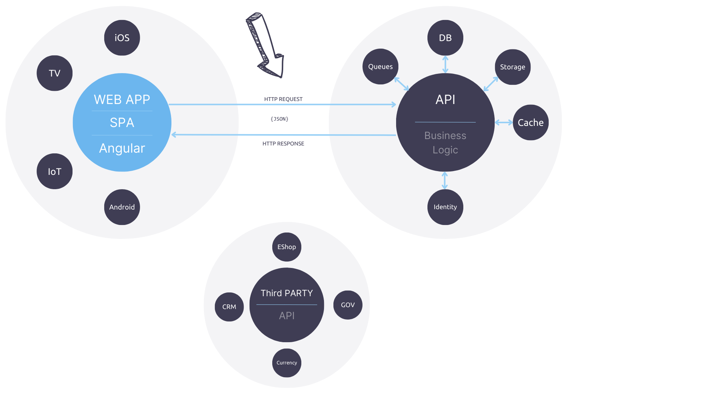

Slide 10
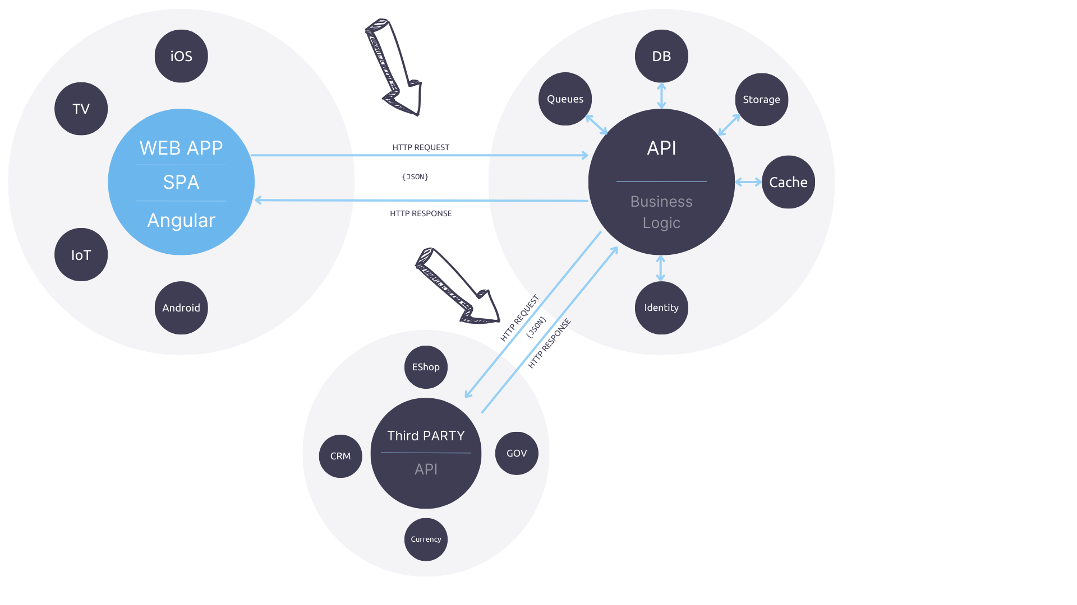

Slide 11
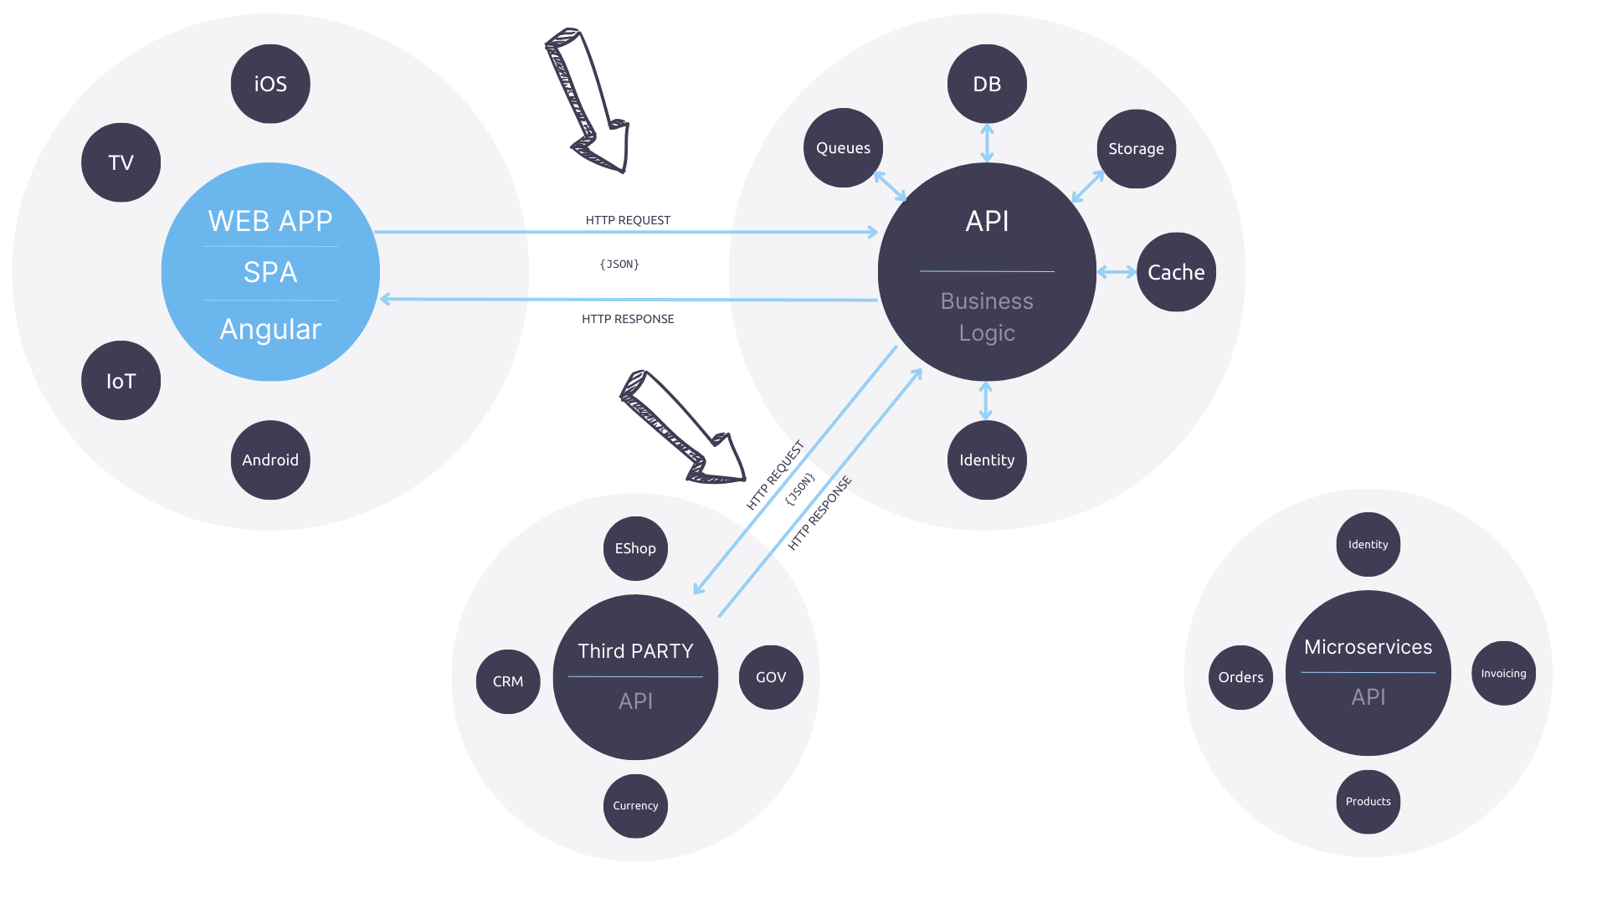

Slide 12
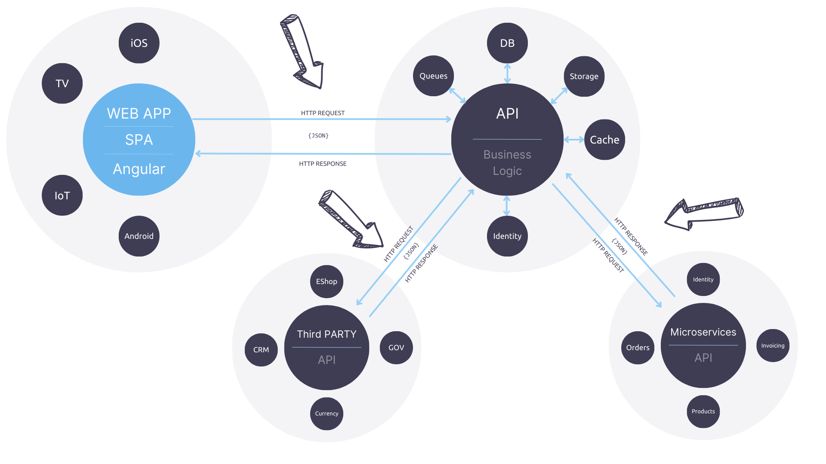

Slide 13
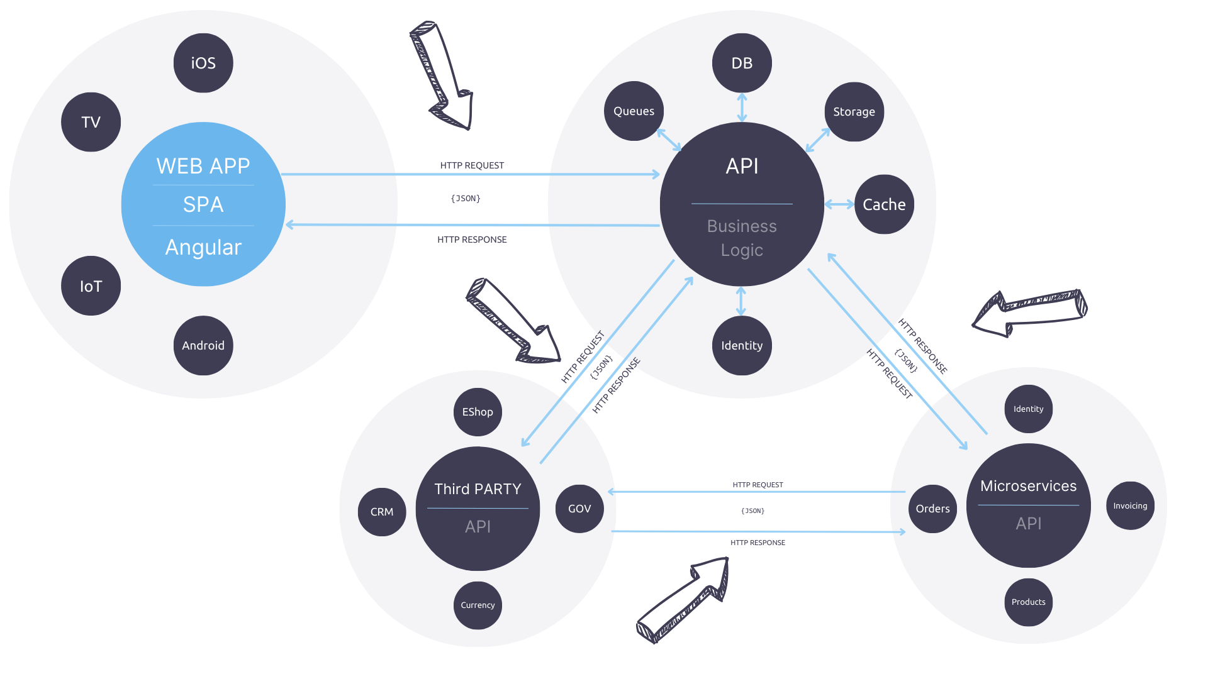

Slide 14
HTTP Request

Slide 15
HTTP Request
Method
Path
Protocol version
GET /contacts/42 HTTP/2
Host: api.contactsdemo.com
Accept: application/json
User-Agent: FRI-Browser/1.0
Headers

Slide 16
HTTP Response
Protocol version
Status code
HTTP/2 200 OK
Content-Type: application/json
Content-Length: 120
{
"id": 42,
"firstName": "John",
"lastName": "Doe",
"email": "john.doe@example.com",
"phone": "+421987654321"
}
Headers
Body

Slide 17
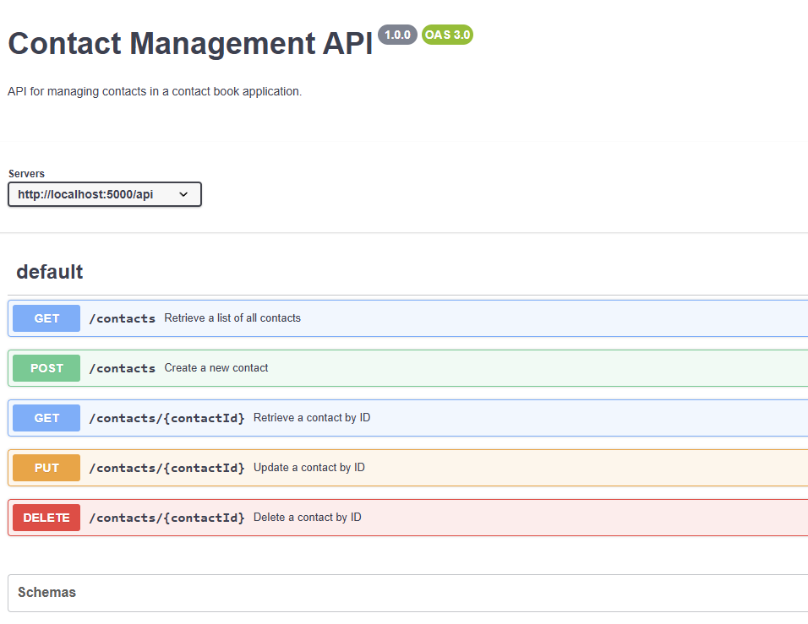


Slide 18


Slide 19
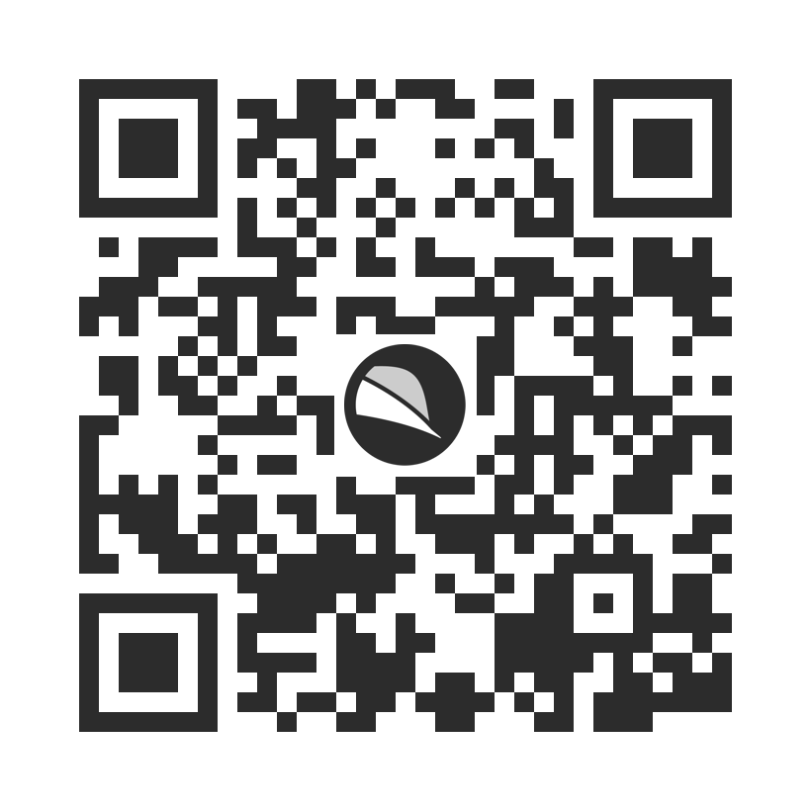

Feedback

Slide 20
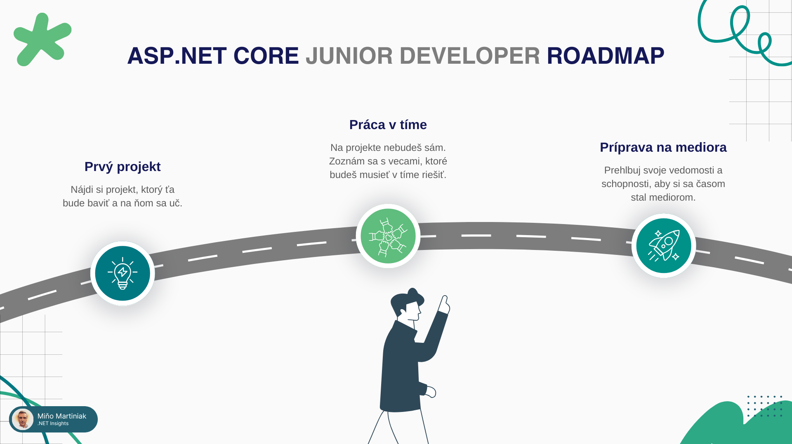


Slide 21
Ďakujem

